Slide 1
Optimizing Vision-Based Trajectory Prediction and Collision Avoidance in Adverse Weather Using V2X Communication
Dissertation​ Abstract
Sandeep Patil

Slide 2
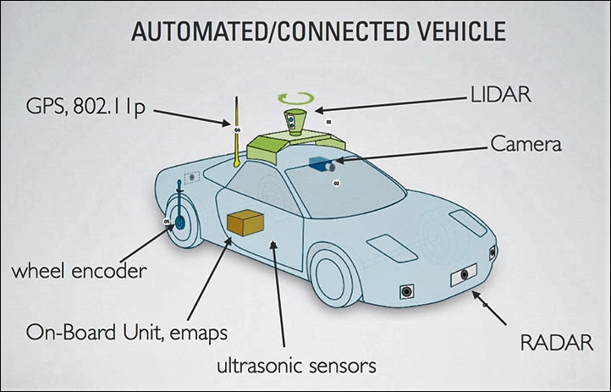
Current State - Vehicle Sensors

Slide 3
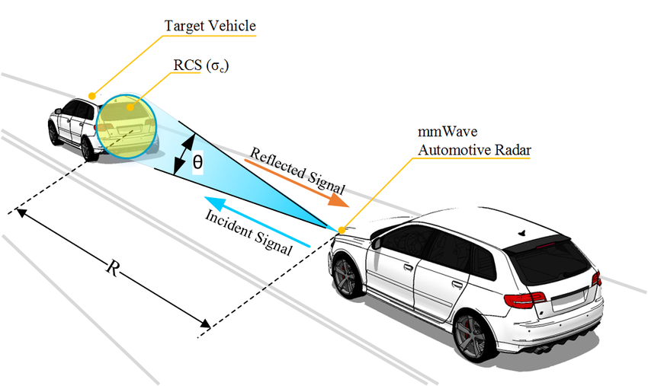
Current State - Vehicle Collision Detection
RAdio Detection And Ranging (RADAR)

Slide 4
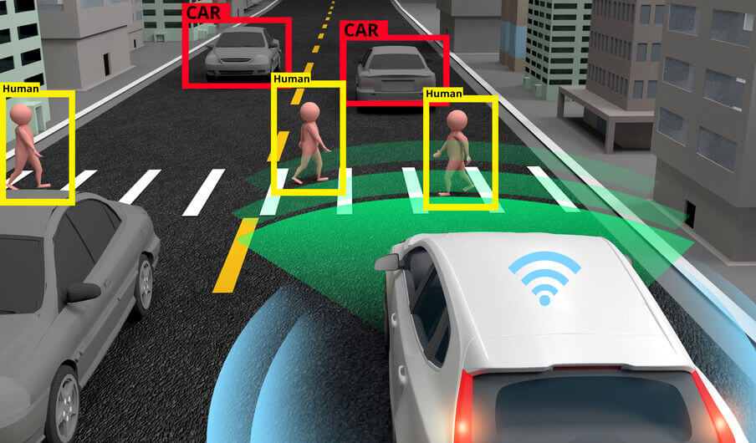
Current State - Vehicle Collision Detection
Camera

Slide 5
Current State - Key Challanges
Radar:
Limited spatial resolution, making it hard to differentiate between objects.
Struggles to predict intent (e.g., braking or lane changes) of other vehicles.
Requires line-of-sight, limiting its ability to detect objects behind obstacles.
Vision-Based Systems (Cameras):
Reduced visibility and object detection accuracy in adverse weather.
Limited ability to detect and react to unseen or occluded objects.

Slide 6
From Challenges to Solutions: Project Overview
Objective
Enhance autonomous vehicle safety by addressing challenges in adverse weather conditions and blind spots caused by out-of-line-of-sight scenarios.
Proposed Solution
Integrate computer vision, Vehicle-to-Everything (V2X) communication and machine learning to:
Enhance object detection and trajectory prediction
Provide real-time decision-making for collision avoidance using fused data.

Slide 7
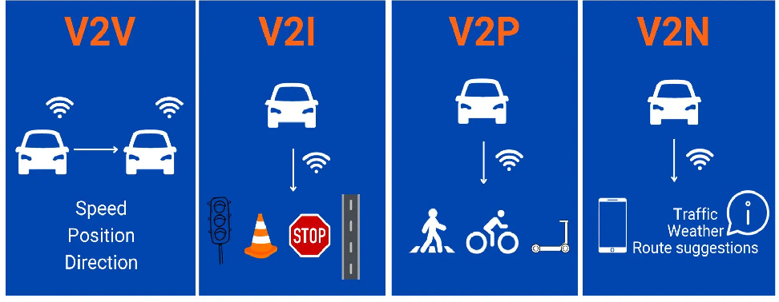
What is Vehicle-to-Everything (V2X) Communication

Slide 8
V2X Implementations Around the World
Europe Converging towards 5G-V2X Including Direct Communications (https://5gaa.org/open-statement-europe-converging-towards-5g-v2x-including-direct-communications/)
The Utah Department of Transportation tested V2X technology to provide signal preemption for snowplows, enhancing operational efficiency and safety during snow removal.(https://www.itskrs.its.dot.gov/briefings/executive-briefing/vehicle-everything-v2x-technology)
Volkswagen Adds ‘Vehicle-To-Everything’ Communications To Revamped Golf With NXP Chips( https://www.forbes.com/sites/samabuelsamid/2019/10/28/volkswagen-includes-nxp-v2x-communications-in-8th-gen-golf/)
Toyota has been equipping its vehicles with V2X systems utilizing Dedicated Short Range Communications (DSRC) technology. (https://yocharge.com/blog/vehicle-to-everything-v2x-technology/)
Leading automotive, telecom and ITS companies unveil first announced cellular V2X trials in Japan (https://usa.nissannews.com/en-US/releases/leading-automotive-telecom-and-its-companies-unveil-first-announced-cellular-v2x-trials-in-japan)

Slide 9
Why V2X is Critical for This Project
Addresses Adverse Weather Challenges:
Provides precise, numerical data when vision-based systems fail (e.g., fog, rain, or snow).
Handles Blind Spots:
Shares data about vehicles or objects beyond line-of-sight (e.g., around corners or behind obstructions).
Enables Predictive Modeling:
Supplies structured, real-time information for trajectory prediction using LSTM models.
Improves Safety and Decision-Making:
Facilitates real-time collision detection and avoidance with low latency.

Slide 10
System Architecture
Key Components:
Vision-Based Object Detection and Radar :
Uses cameras with models like YOLO and Radar for detecting vehicles, pedestrians, and obstacles.
V2X Communication Integration:
Combines data from vehicles, infrastructure, and pedestrians to enhance situational awareness.
Data Fusion Module:
Fuses vision-based detections and V2X inputs to create a unified representation of the environment.

Slide 11
System Architecture
Key Components:
4) Trajectory Prediction Module:
Employs LSTM models to predict the future movement of vehicles and pedestrians based on fused data.
5) Collision Detection System:
Analyzes trajectories to detect potential collisions and compute metrics like Time-to-Collision (TTC).
6) Collision Avoidance Module:
Uses reinforcement learning to determine optimal actions, such as braking to avoid collisions.
7) Kalman Filter for Multi-Sensor Fusion and Stabilization (Vision + RADAR + V2X)

Slide 12
Simulation and Testing in CARLA
Objective:
Validate the system's performance under diverse traffic and weather scenarios using the CARLA simulator.
About CARLA:
CARLA is an open-source autonomous driving simulator that provides realistic environments for testing and validation.
With CARLA we can :
Simulate urban and highway scenarios with realistic traffic conditions.
Simulate vehicle-to-vehicle (V2V), vehicle-to-infrastructure (V2I), and vehicle-to-pedestrian (V2P) communication.
Add adverse weather effects like fog, rain, and snow.

Slide 13
Vision-Based Object Detection
Objective:
Detect vehicles and obstacles in real-time
Estimate object distance and potential collision risk.
Models Used:
YOLOv8 (You Only Look Once):
Real-Time Speed – Processes images in a single pass, making it faster than two-stage detectors like Faster R-CNN.
High Accuracy – Improved detection performance with anchor-free architecture and better bounding box precision.
Lightweight – Runs smoothly on GPUs and edge devices.
Seamless Integration – Works with CARLA simulation, provides object detection data for LSTM-based trajectory prediction and collision risk estimation.

Slide 14
Vision-Based Object Detection Workflow
1. Camera Sensor Capture:
A RGB camera is mounted on the ego vehicle in CARLA.
Captures live frames and feeds them into the YOLO model.
2. YOLOv8 for Object Detection:
The model identifies surrounding vehicles and obstacles.
Bounding boxes are generated for detected objects.
Objects are classified and assigned confidence scores.

Slide 15
Vision-Based Object Detection Workflow
3. Distance Estimation from Bounding Boxes:
The bounding box width is used to estimate the distance of objects.
Closer objects have larger bounding boxes.
Used to calculate Time-to-Collision (TTC).

Slide 16
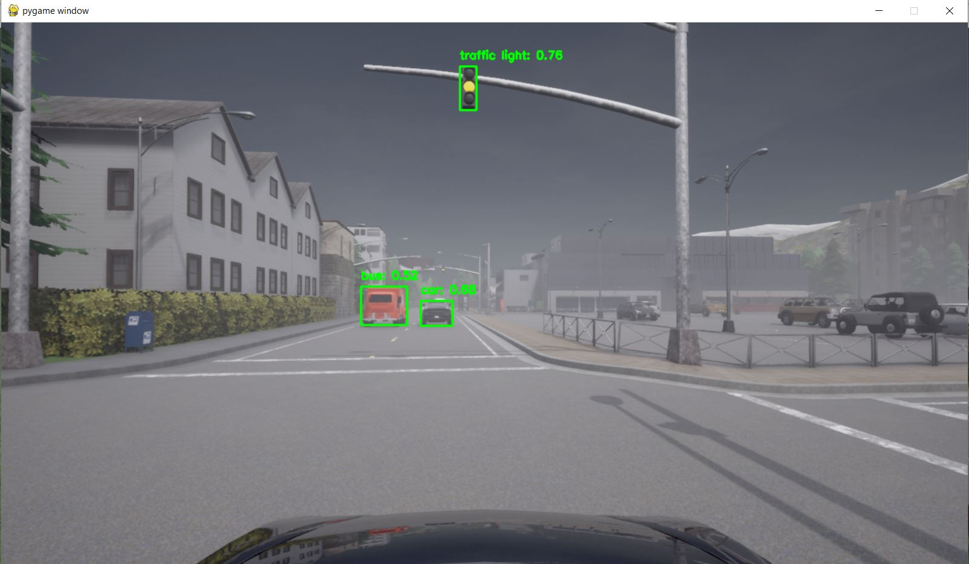
Vision-Based Object Detection Simulation

Slide 17
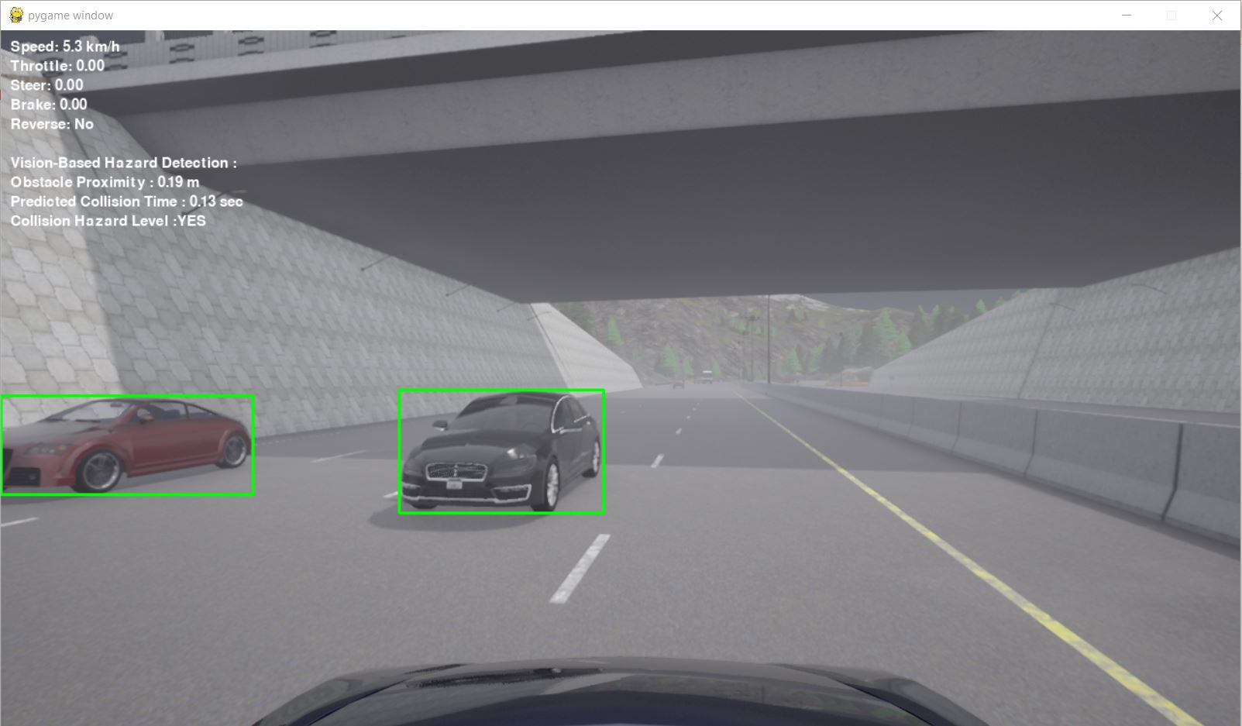
Vision-Based Object Detection Simulation

Slide 18
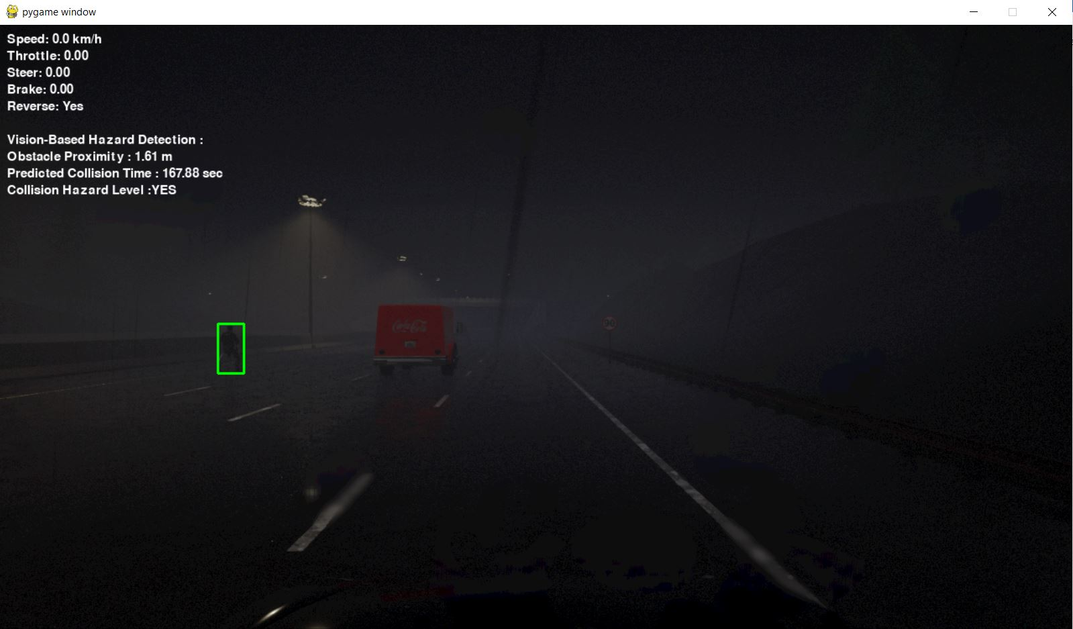
Vision-Based Object Detection Simulation

Slide 19
Radar Based Object Detection
Objective
Detect obstacles and vehicles using radar sensors.
Measure distance and velocity of objects for collision risk estimation.
Workflow
1. Radar Sensor Integration:
A radar sensor is mounted on the ego vehicle in CARLA.
Continuously scans for objects within a 100m range.

Slide 20
Radar Based Object Detection Workflow
2. Distance & Velocity Measurement:
Radar detects objects even in poor visibility (fog, rain, darkness).
Provides real-time depth and relative velocity of nearby vehicles.
3.Time-to-Collision (TTC) Calculation:
Uses radar data to estimate TTC based on distance and relative speed.
Helps in predicting collisions before they happen.

Slide 21
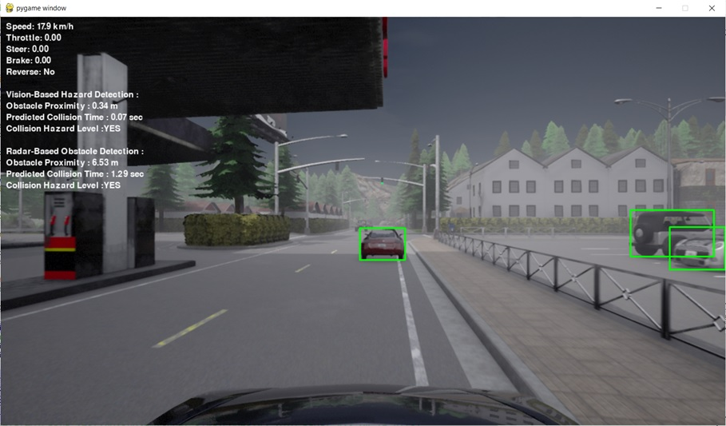
Radar Based Object Detection Simulation

Slide 22
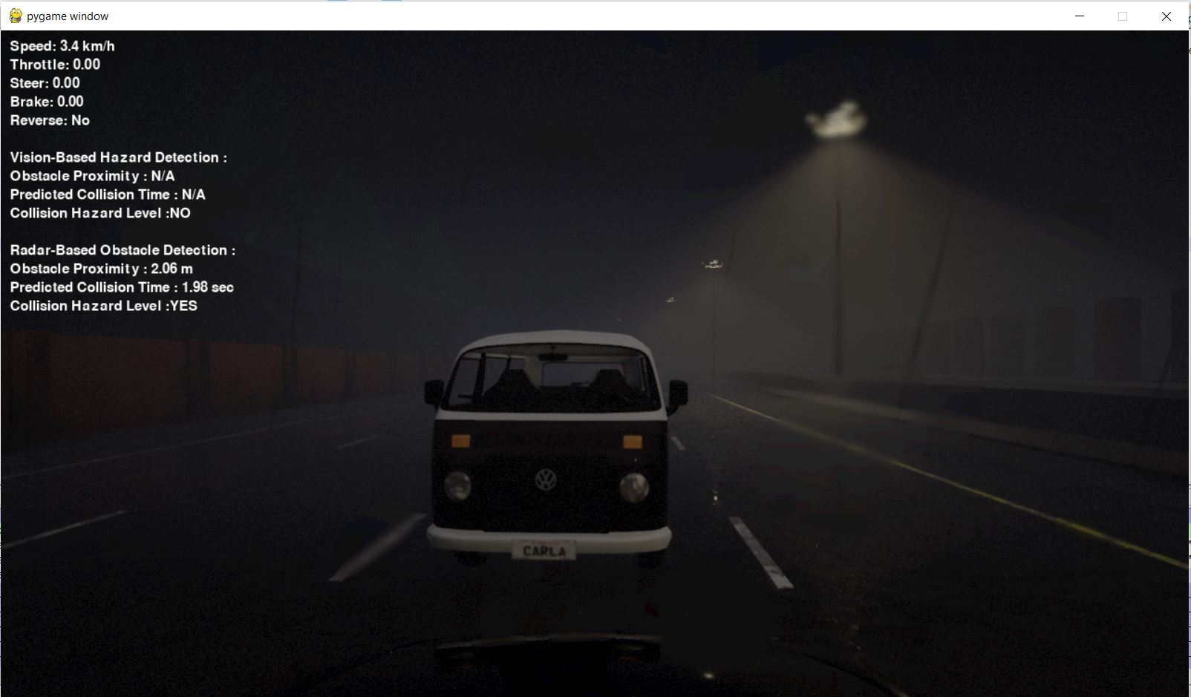
Radar Based Object Detection Simulation

Slide 23
V2X-Based Collision Prediction
Enabled V2X communication in CARLA to exchange vehicle states.
Vehicles broadcast position, velocity, and acceleration in real-time.
Ego vehicle receives data to predict future trajectories of surrounding vehicles.
Improved occlusion handling: detects vehicles hidden behind obstacles.
Enhanced TTC estimation using real-time V2X inputs.

Slide 24
LSTM-Based Trajectory Prediction
LSTM (Long Short-Term Memory) networks are a type of Recurrent Neural Network (RNN) that are well-suited for learning sequences.
In this project, LSTM is used to predict the future trajectory of vehicles based on their historical motion data.
Inputs: Position (x, y), Velocity (vx, vy), Acceleration (ax, ay).
Outputs: Predicted positions for the next 20 time steps.
Trained on simulated vehicle trajectories with MinMax scaling.

Slide 25
Pipeline for Vehicle Trajectory Prediction Using LSTM
Data Logging using CARLA Simulation
LTSM Model Training
Real Time Trajectory Prediction
Data Preprocessing

Slide 26
Data Logging using CARLA Simulation
To train the LSTM model, vehicle trajectory data is collected from the CARLA simulator
The trajectory_logger.py script logs the position, velocity, and acceleration of all vehicles in the environment.
Steps :
The ego vehicle (subject vehicle) and surrounding traffic vehicles are spawned with AUTOPILOT mode enabled.
Real-time logging is performed, saving motion states at each timestep.
The dataset is stored as a CSV file (carla_all_vehicles_trajectory.csv), which is later used for training.

Slide 27
Data Pre-Processing
Before training, the collected trajectory data needs pre-processing.
The prepare_trajectory_data.py script performs pre-processing using following steps:
Loads the logged dataset(carla_all_vehicles_trajectory.csv) and sorts it by vehicle_id and timestep.
Normalizes features (position, velocity, acceleration) using MinMaxScaler.
Creates input sequences of 10 timesteps and predicts the next 5 timesteps.
Saves the processed data as NumPy arrays (X_trajectory.npy, Y_trajectory.npy).

Slide 28
LTSM Model Training
The train_lstm_trajectory.py script trains an LSTM-based model for trajectory prediction.
The architecture consists of:
An LSTM layer that captures temporal dependencies.
A fully connected layer that maps hidden states to output coordinates.
The model is trained using Mean Squared Error (MSE) loss and the Adam optimizer.
Training involves the following:
Load the pre-processed dataset (X_trajectory.npy, Y_trajectory.npy).
Convert it into PyTorch tensors and use a DataLoader for efficient batch processing.
Train for 10 epochs and save the model as lstm_trajectory_model.pth.

Slide 29
Real Time Trajectory Prediction
During simulation, the LSTM model is continuously used to predict future positions of vehicles in real-time. This is implemented in final python code.
The get_vehicle_state() function retrieves the position, velocity, and acceleration of a vehicle in each simulation frame.
These features are continuously collected for each vehicle and stored as historical sequences.

Slide 30
Real Time Trajectory Prediction
The last 10 timesteps of a vehicle's motion history are used as input to the LSTM model.
When enough historical data is available (at least 10 timesteps), it is converted into a PyTorch tensor and passed to the trained LSTM model.
The model predicts the next 20 positions (x, y coordinates) of the vehicle.
These predicted future positions are used to estimate potential collisions by checking for overlaps with other predicted trajectories.

Slide 31
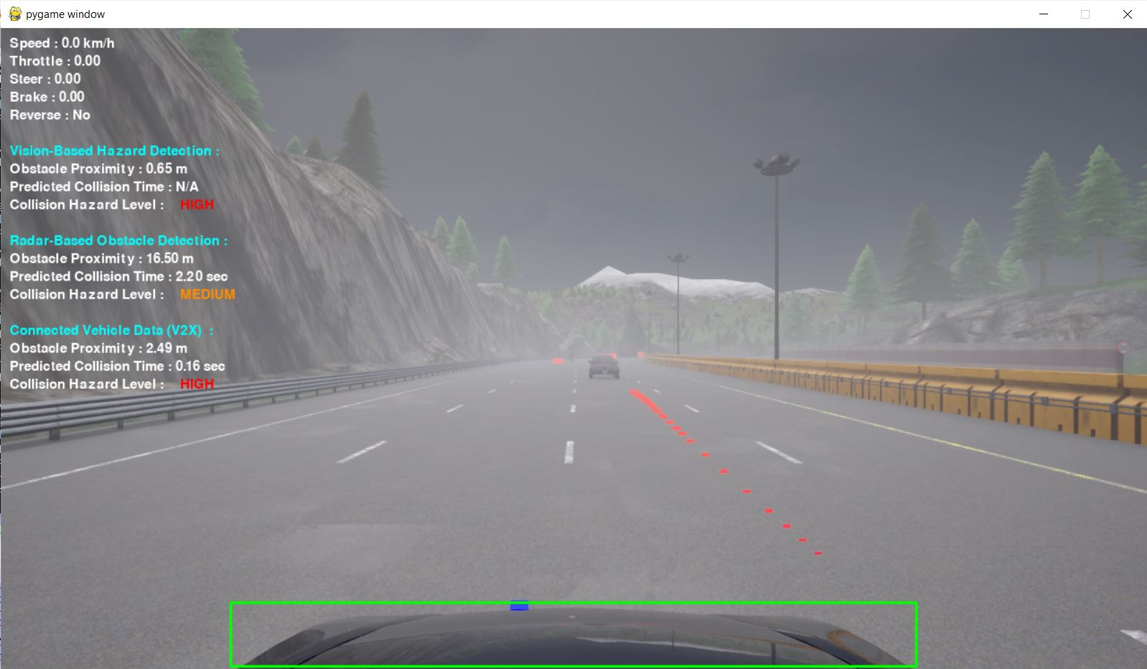
LSTM-Based Trajectory Prediction

Slide 32
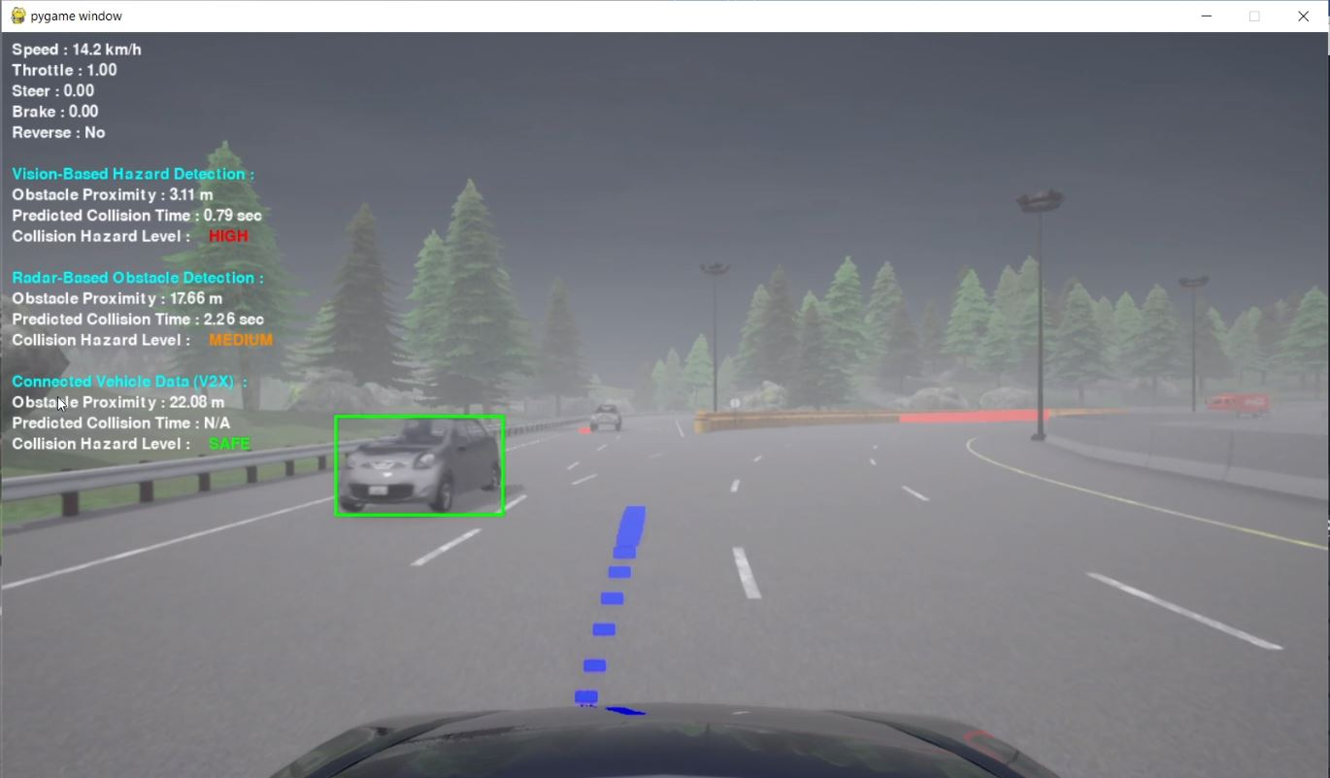
LSTM-Based Trajectory Prediction

Slide 33
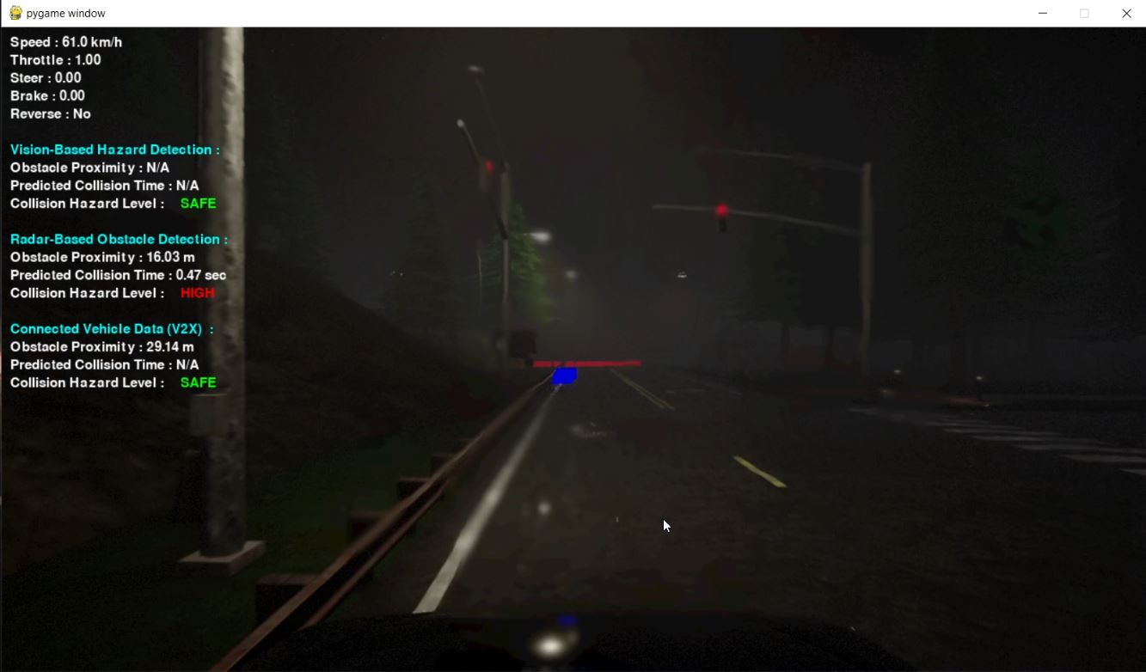
LSTM-Based Trajectory Prediction

Slide 34
Collision Detection and Avoidance
Objective:
Detect potential collisions and implement real-time strategies to avoid them.
Collision Detection:
Trajectory Analysis:
Predicted trajectories from the LSTM model are evaluated for possible intersections.
Time-to-Collision (TTC):
Compute TTC to assess the urgency of potential collisions.
Risk Classification:
Scenarios are categorized as Safe, Warning, or Critical based on collision likelihood and TTC.

Slide 35
Collision Detection and Avoidance
Objective:
Detect potential collisions and implement real-time strategies to avoid them.
Collision Avoidance:
Decision-Making:
Reinforcement Learning (RL) determines optimal maneuvers such as braking. (Could not implement accelerating, or lane changes due to limited time for implementation.)
Real-Time Execution:
RL agent ensures minimal delay in implementing avoidance actions.
Adverse Weather Handling:
Prioritizes V2X data when vision-based inputs are unreliable (e.g., during fog or rain).

Slide 36
Kalman Filter for Sensor Fusion
Objective:
Smooth risk levels calculated from Vision-based, Radar, and V2X data.
Provide a stable and filtered risk assessment for collision avoidance.
Improve Time-to-Collision (TTC) prediction accuracy by reducing sensor noise.
Workflow :
1. Sensor Data Fusion:
The system receives risk levels from Vision, Radar, and V2X communication.
Each risk level is mapped to a numeric value:
SAFE = 0, LOW = 1, MEDIUM = 2, HIGH = 3.

Slide 37
Kalman Filter for Sensor Fusion Workflow
2. Kalman Filter for Risk Smoothing:
Maintains an internal state of the current risk level.
Predicts risk level at the next timestep using the state transition model.
Updates the risk estimate using new sensor data, balancing past predictions with new observations.
3. Weighted Sensor Fusion:
Radar risk is given higher priority (60%) due to accuracy in velocity measurement.
YOLO and V2X contribute 30% and 10%, respectively.
The Kalman filter adjusts dynamically to sudden risk level changes.

Slide 38
Kalman Filter for Sensor Fusion Workflow
4. Final Risk Level Used for Decision Making:
The smoothed risk output is used to trigger Automatic Emergency Braking (AEB) if necessary.
Ensures stable braking decisions instead of reacting to noisy detections.
Key Advantages of Kalman Filtering in Risk Estimation:
Removes fluctuations in risk levels caused by sensor noise.
Smooths sudden jumps in detection confidence.
Ensures consistent emergency braking activation, preventing unnecessary

Slide 39
Automatic Emergency Braking (AEB)
AEB activates when collision risk is HIGH based on output of multi-sensor fusion.
AEB also overrides manual control when Radar Based Hazard Detection detects Time-to-Collision (TTC) < 2 sec OR Distance < 5m as Radar has higher priority than other sensors.
Manual override ensures driver control.
Tested in various traffic and weather conditions in CARLA.

Slide 40
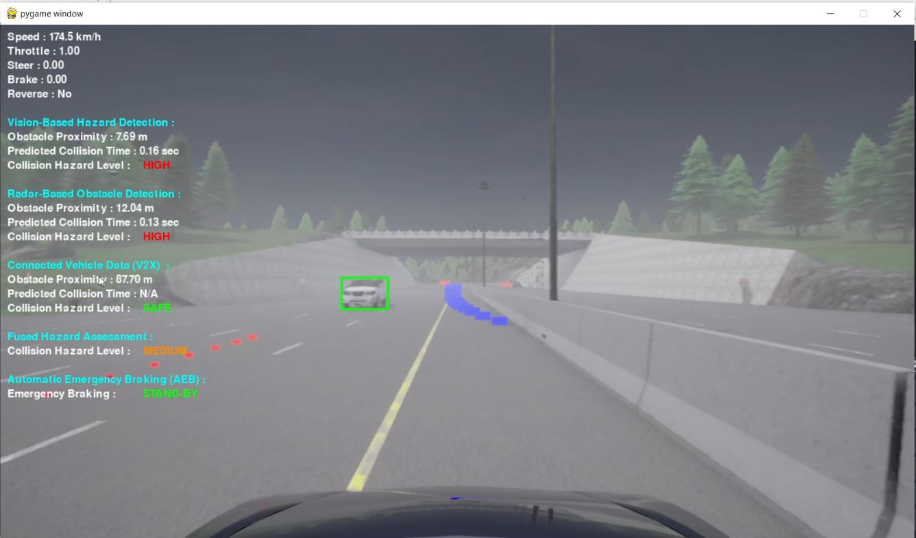
Final Simulation Environment

Slide 41
Simulation Results and Performance Analysis
Vision-Based Object Detection
Enabled real-time obstacle detection using Vision-based deep learning.
Effective in clear visibility but struggled in adverse weather conditions.
Depth estimation limitations led to inaccuracies in risk prediction.
Radar-Based Obstacle Detection
Provided direct depth measurements for more accurate distance estimation.
Reliable in low-visibility conditions where Vision-Based Object Detection struggled.

Slide 42
Simulation Results and Performance Analysis
V2X-Based Trajectory Prediction
Enabled vehicles to share position, velocity, and trajectory data for predictive risk assessment.
Helped detect occluded vehicles (e.g., behind buildings, at intersections) before visual or radar detection.
Dependent on the availability of V2X-equipped vehicles, limiting its reliability in some scenarios.

Slide 43
Simulation Results and Performance Analysis
Multi-Sensor Fusion with Kalman Filter Stabilization
Combined Vision, Radar, and V2X data to maximize detection accuracy.
Kalman filter smoothed risk estimations, reducing false positives and fluctuations.
Provided the most reliable and adaptive collision risk assessment across all conditions.

Slide 44
Thank You!

